Slide 1
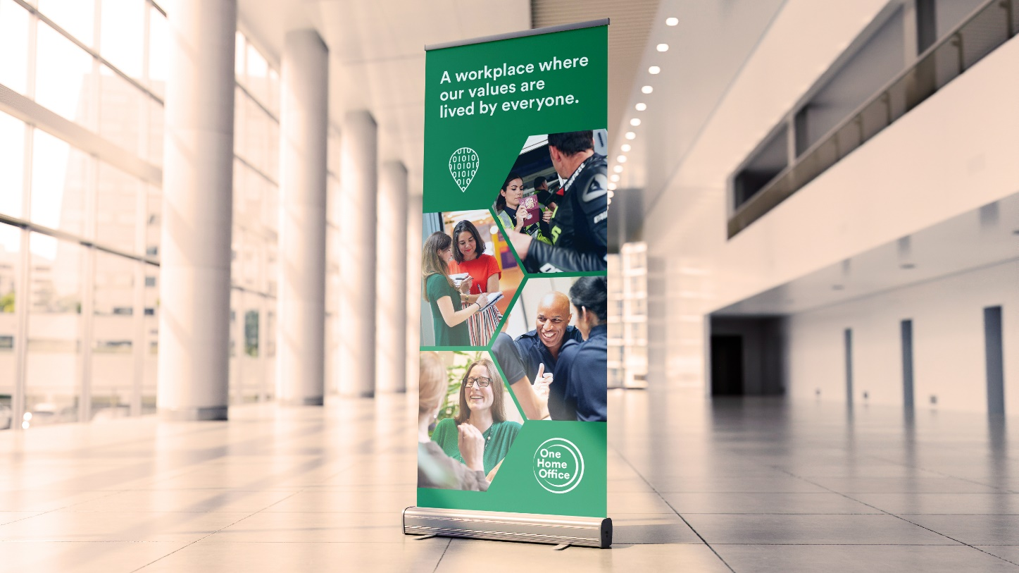
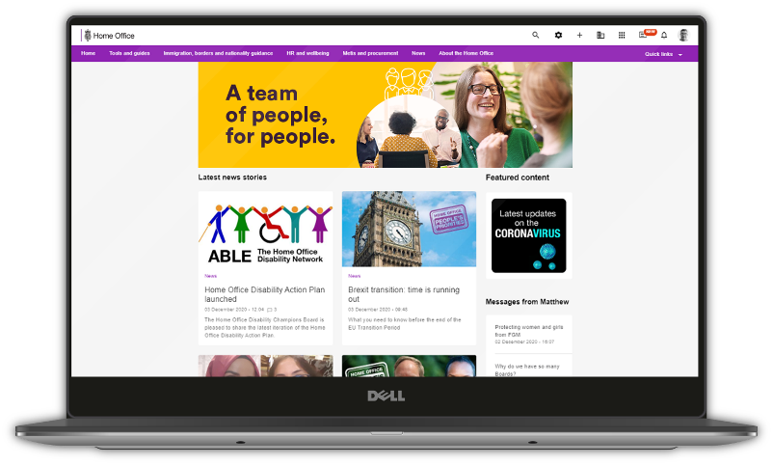
Stakeholder Outreach Welcome Pack

Slide 2
Home Office Values
Respectful
We treat everyone fairly, respecting individual perspectives and valuing and embracing our differences to create an inclusive environment.
Courageous
We are outward looking and professionally curious, testing new ideas while encouraging challenge and being bold in our pursuit of delivering outcomes for the public.
Compassionate
We act ethically, with honesty, care and sensitivity, seeking to understand the realities and perspectives of the people we serve to build trust and confidence.
Collaborative
We work as one team, listening to and supporting each other and our stakeholders, working across boundaries to improve outcomes for the public.

Slide 3
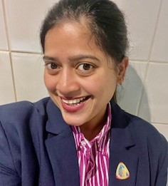
Meet the Team
My name is Shabnaz Rahman, and I am from Bangladesh. I am the Senior Operational Manager-Stakeholder Outreach & Briefing Lead for the Windrush Compensation Scheme (WCS).
I joined the WCS almost two years ago as a Quality Assurance Manager and worked with passionate colleagues to provide compensation for our customers. I wanted to continue with the positive work and to make a difference right at the forefront of our customer service. In 2023 I moved to the engagement operation, where My team and I work to increase awareness of the scheme through community events and stakeholder engagement.

Slide 4
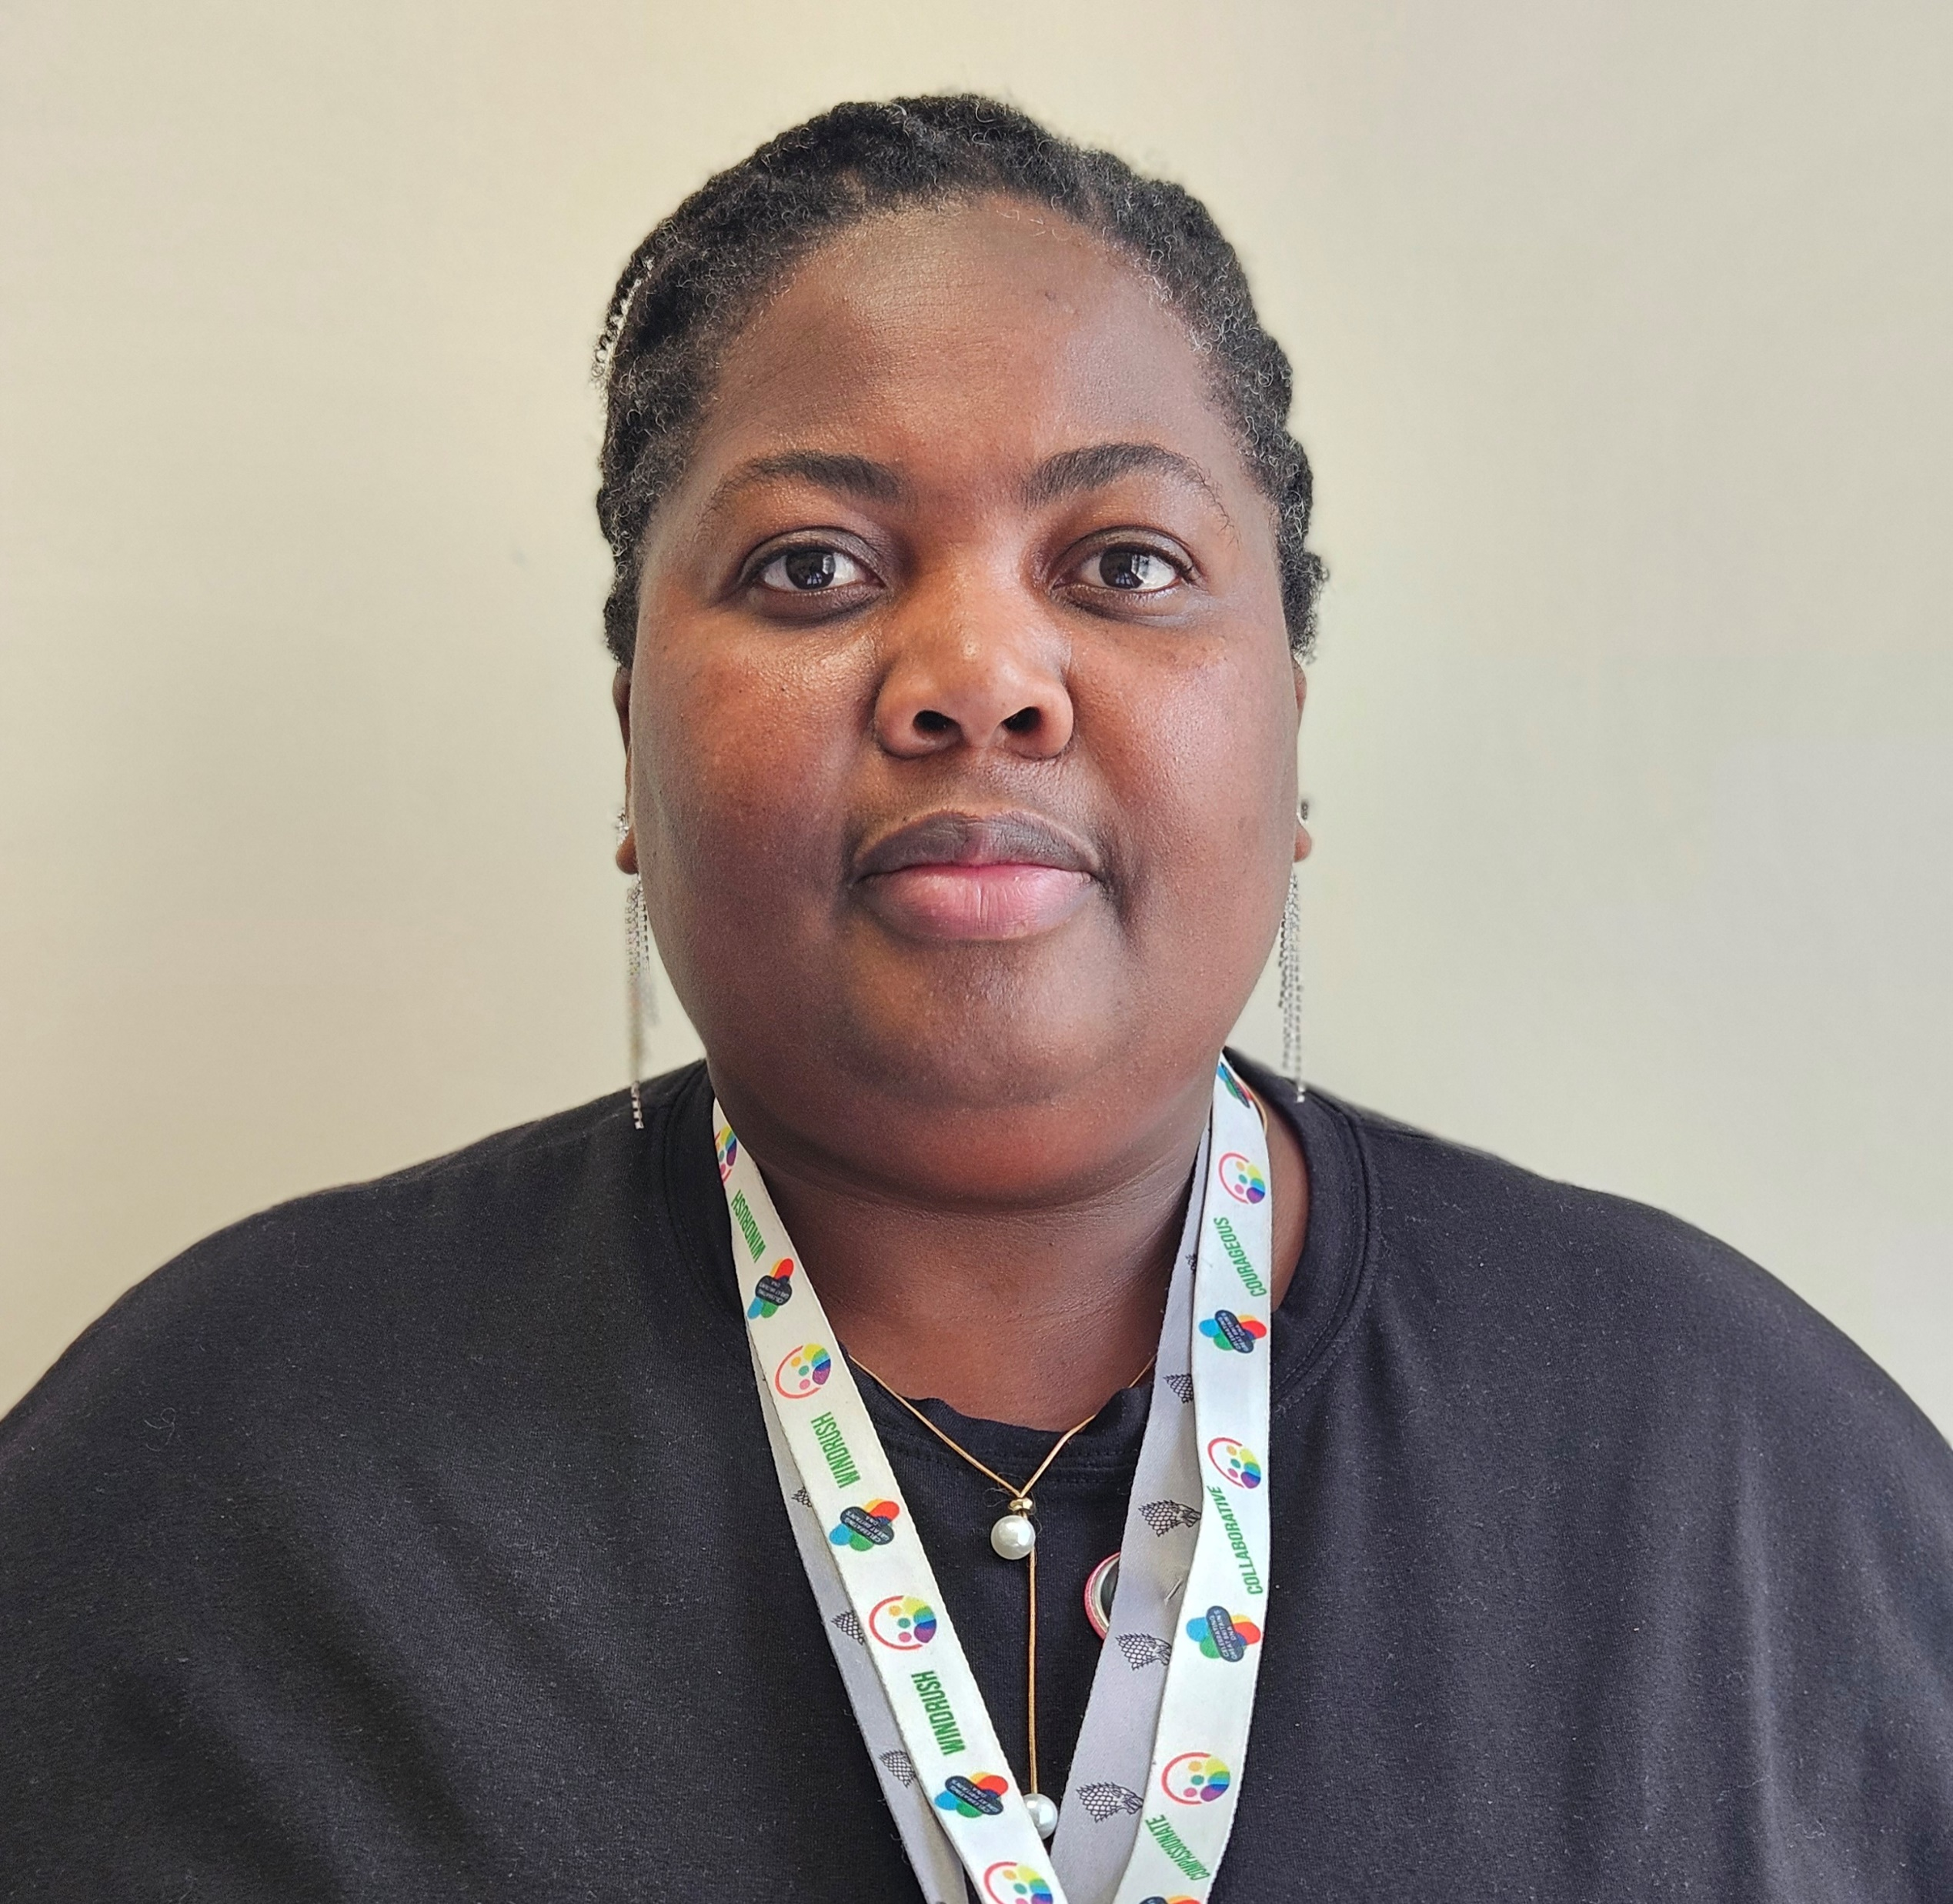
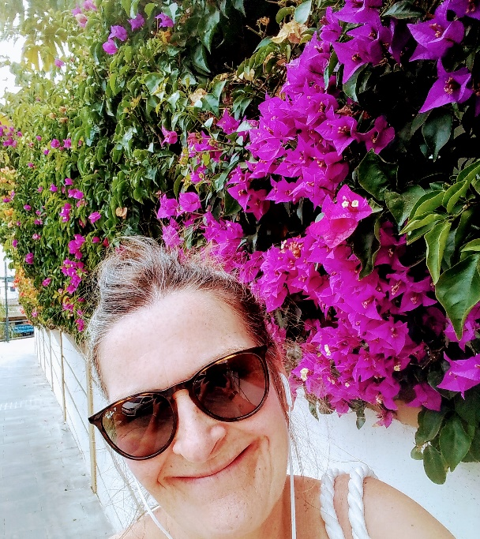
Meet the Team
My Name is Tracy Mpofu I am an HEO on Stakeholder Outreach & Briefing Lead. I joined the Windrush Compensation Scheme in June 2020 as a Quality Manager.
As a Windrush volunteer and someone from the commonwealth, this drove my passion into helping people who were affected by the scandal. The majority of those people are like me.
In 2023, I transitioned into the engagement team where I continue to help customers in a different manner. Therefore, in 2024 when the opportunity arose to work with new stakeholders to promote the scheme, I could not be more enthralled. To me it means I have to reach as many people as possible who might be entitled to compensation and to raise awareness of the scheme and what Windrush is about. It should not be forgotten!
Hi, my name is Jayne Wingfield – I work on Stakeholder Outreach Team within Windrush, I have previously worked on the Windrush Helpline, Windrush Registration team and most recently the Vulnerable Person Team, so I possess a wide knowledge of the different teams and our customer base.
I joined the Home Office and the Windrush department in 2022, coming from Department of Work and Pensions( DWP) where I brought along my lived enriched experience of working amongst and helping the most vulnerable customers in our society.
I felt a strong connection with Windrush as my own father was an Irish immigrant and I felt that I needed to put wrong things right and to enable the Windrush customers that are entitled to achieve the compensation they deserve. I will honour my commitment to ensure that I help each and every one of them.

Slide 5
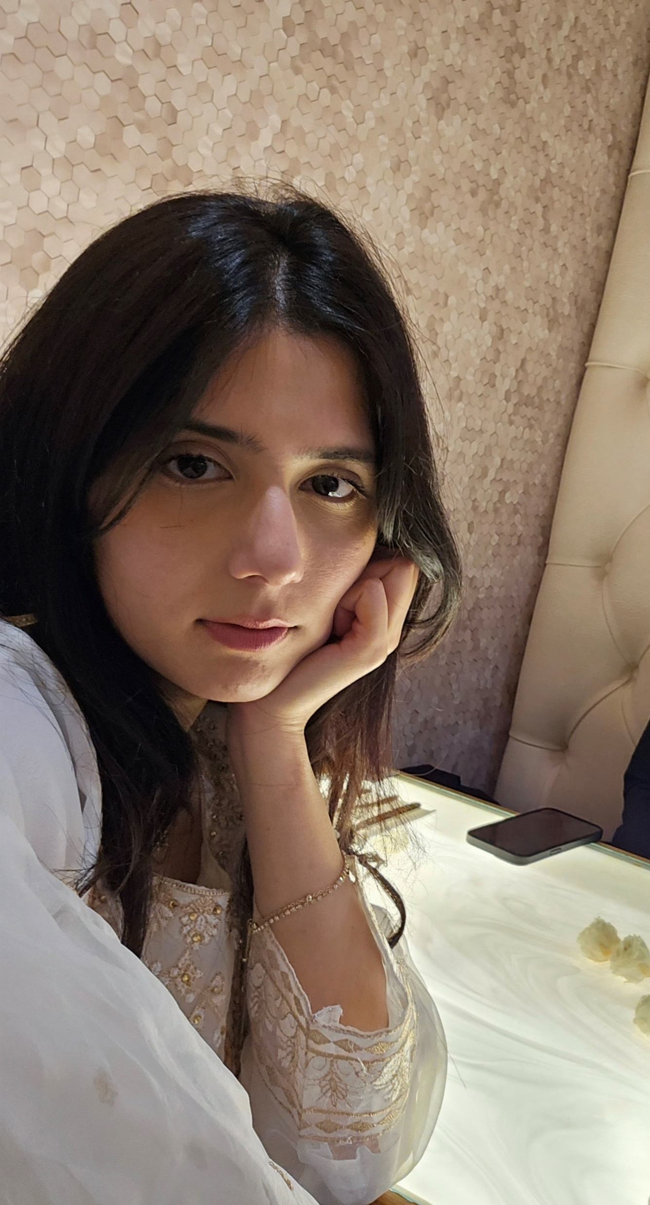
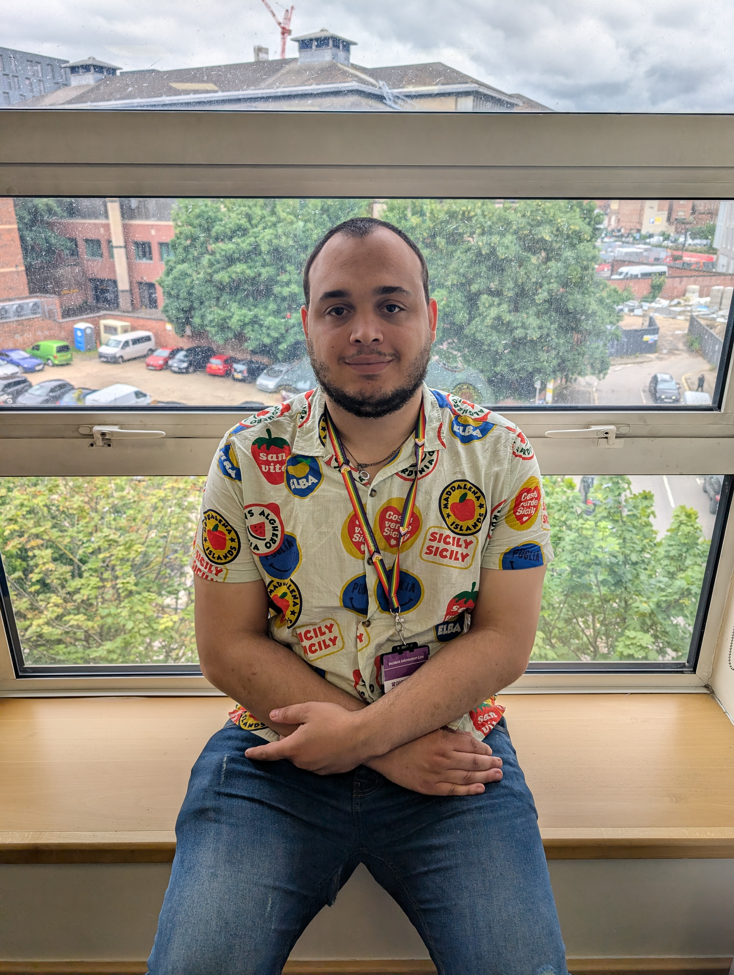
Meet the Team
My name is Saira. For the past few years, I have worked in the Home Office in various departments within the Windrush Team. I have worked as a caseworker, and a contact manager. These role further increased my passion to continue to work within Windrush.
My current role as Stakeholder Outreach has given me the opportunity to research and explore South Asian communities and raise their awareness on Windrush. Being South Asian myself I feel a strong sense of responsibility and joy in working with communities that share my roots. My overall purpose is to bring awareness to people from any nationalities that may have been affected by the Windrush scandal.
My name is Marcus Talbot. I joined the Windrush Compensations Scheme in September 2021 as a Helpline advisor.
With part of my family being from the Commonwealth it has made me really engaged in helping people who have been affected by the Windrush scandal.
Within the Windrush Schemes I have been on several teams such as the Helpline, the Registration Team, the Probate Team, and the Contact Manager Team. Hence, I have a wide range of knowledge. I have recently joined the stakeholder outreach team which will allow me to meet customers in person and spread information to people who have possibly been affected by the scandal which is really exciting.

Slide 6
Windrush Introduction
In 1948, members of the Windrush generation began to migrate to the United Kingdom (UK), upon invitation from the British government following the World War II. These individuals had no immigration restrictions and were legally permitted live and work in the UK.
On 1 January 1973, the Immigration Act 1971 came into force which meant that individuals living in the UK were automatically granted a formal immigration status called Indefinite Leave to Remain (ILR). But many of the Windrush generation were not aware of this and did not obtain the legal document.
Further changes to immigration and nationality laws resulted in long term residents requiring documents to prove their legal right to be in the UK – something they had not needed under previous laws. This meant that some of the Windrush generation lost their jobs and were unable to access essential services such as healthcare and benefit for many years.
The Windrush Scandal emerged in 2018 and exposed the significant flaws in the immigration policies and the impact this had on the Windrush generation.

Slide 7
Home Office response to the Windrush Scandal
The first step taken by the Home Office was to establish a dedicated team to help those affected by the scandal, assisting them in obtaining the necessary documentation to prove their right to stay in the UK.
A Compensation scheme was later set up to compensate individuals for losses due to their status.
In addition, the Windrush Customer Support and Engagement Team was set up. The Engagement team works with stakeholders to raise awareness of the assistance available for the Windrush generation.
The Windrush Customer Support and Engagement Team consists of two Teams
The Stakeholder Outreach team which is us – our role is to reach to potential stakeholders to identify and work with them to find ways in which we could raise awareness of Windrush.
The Stakeholder Events Team – our colleagues who attend events to deliver presentations, Q&A session, 1-1 consultations, advocacy training and or information stands
Thank you for expressing an interest in working with us.

